Slide 1

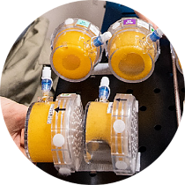
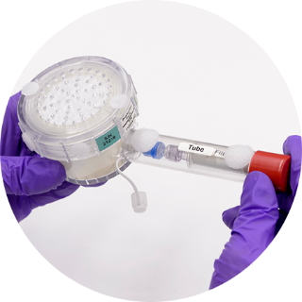
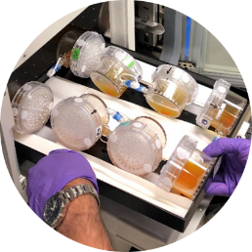
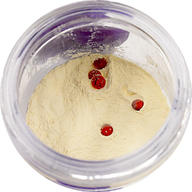
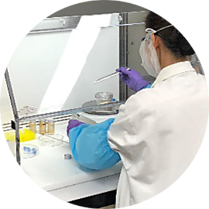
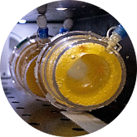
Space Technology Mission Directorate
Game Changing Development Program
PPBE 22 – Existing Projects – New Content
John Hogan| FY20 Synthetic Biology| 02.28.20

Slide 2

Existing Project - BioNutrients New Additional Content
Summarize where the technology will be at the current end of project
Delivered and tested in low earth orbit a platform technology for the on-demand microbial manufacturing of multiple human nutrients to mitigate nutrient deficiencies in the current pre-packaged food system for long duration missions.
Conduct 5-year test of a production pack system that enables required nutrient production after long-duration storage of the microorganisms and media, requires minimal mass and volume, and complies with required food safety requirements.
Develop and flight test a Hazard Analysis and Critical Control Point (HACCP) plan and in-space monitoring methods for ensuring food safety requirements for future implementation during missions.
Summarize additional content
Automation of nutrient production pack operation to ensure product consistency, reduce crew time, and monitor/maintain safety.
Work with HRP Food Systems (JSC) to go beyond demonstration to provide a viable edible product and associated safety protocols.
Identify/develop new products to support exploration missions – additional nutrients, pharmaceuticals, and high value compounds.
Provide a clear statement of “why” the additional content needs to be developed and the importance/nature of additional content being proposed
Automation will allow for production with minimal crew intervention, and can decrease human error and variability.
Nutrient requirements are evolving, with an expectation that multiple compounds and means of delivery of those compounds will become required as the nutrient and pharmaceutical requirements mature.
Developing a method to deliver an edible microbial food product in flight and consumption by crew will be instrumental to identifying and addressing challenges in palatability, acceptability, safety, and reliability.

Slide 3
Existing Project – CO₂-Based Manufacturing New Additional Content
Summarize where the technology will be at the current end of project
A ground tested, reduced gravity-compatible prototype with “space-ready” microbe(s), producing carbonic anhydrase from CO₂-derivable feedstock. (TRL 3/4)
Use case scenarios and systems analysis for Lunar and Martian surface missions.
Summarize additional content
Refinement of production platform for Lunar or Martian surface mission deployment (increasing overall system TRL to 4, some components to 5).
Facilitate development and integration of newly developed SOA CO₂ conversion technologies to increase production potential (e.g. sugars) of microbial growth substrate.
Novel product identification and production via microbial engineering (e.g. nutrients, pharmaceuticals, food, additional enzymes/products).
Provide a clear statement of “why” the additional content needs to be developed and the importance/nature of additional content being proposed
To meet the evolving in-space manufacturing requirements of future Lunar and Martian surface missions, providing a test platform for reliable, safe, low ESM CO₂-based manufacturing capabilities.

Slide 4
BioNutrients New Additional Content - Approach
Describe how and when technology will be infused in future systems
Describe how the technologies work together and are used in system performance
Expansion of nutritional products, assessment of palatability/acceptability and use of products by crew on ISS. This supplements the prepackaged food system, addressing critical nutrient degradation in long duration missions.
Automation prototyping to decrease crew time, increase safety, performance and utility of BioNutrients products and platform.
Supports draft HRP Food Roadmap that proposes inflight testing (including Lunar surface) in the 2028/29 timeframe.
Describe any known interface requirements and/or interdependencies for other technologies/capabilities
Requires water (clean, potable), waste containment/recycling (solid and vapor), and pressurized cabin space, power, crew, controlled temperature environment (may be cabin).
Describe how the additional content will be accomplished
In-house development and flight testing, coordination with HRP Food System Program.
Pull from Industry/Academia – STTR Phase II Sustainable Bioproducts, Center for the Utilization of Biological Engineering for Space (CUBES).

Slide 5
CO₂-Based Manufacturing New Additional Content - Approach
Describe how and when technology will be infused in future systems
Describe how the technologies work together and are used in system performance
CO₂-based manufacturing platform refinement and continued development for Lunar/Martian surface missions will support future bioreactor testing and in situ resource utilization of CO₂.
Technology approach supports increased sustainability missions, including proposed Lunar base establishment in 2028 and future Mars missions.
Project product carbonic anhydrase is targeted enhancement for liquid amine CO₂ removal system for life support.
Describe any known interface requirements and/or interdependencies for other technologies/capabilities
Requires power, water/hydrogen, concentrated CO₂ source, media supplements, thermal control, radiation protection, pressurized volume.
Describe how the additional content will be accomplished
In-house development: engineered organisms, bioreactors and mission implementation assessment.
Leverage cooperative agreement with Kanan lab, Stanford University - CO₂ conversion to microbial substrates. Potentially other academic/industrial partners.
Leverage NASA CO₂ Conversion Centennial Challenge – CO₂ conversion to sugar feedstock (currently in Phase II of competition).

Slide 6
Technology Development & Transition Timeline
Customers
Current: AES Life Support Systems
Carbonic Anhydrase for liquid amine CO₂ removal, directed evolution optimization (funded by AES)
Potential: HEOMD HRP, AES Life Support Systems
HEOMD HRP: Nutrients, yogurt-based food products, pharmaceuticals
AES Life Support Systems: CO₂-Based Manufacturing of carbonic anhydrase, additional products
Fiscal Years | 16 | 17 | 18 | 19 | 20 | 21 | 22 | 23 | 24 | 25 | 26 | 27 | 28 | 29 | 30 | 31
Previous Investment in BioNutrients (AES)
GCD Project Element 1 BioNutrients flight experiment
TRL 5-6
TRL 4
TRL 3
BioNutrients automation prototyping
BioNutrients additional products
Production and use of crew ready, edible products HRP food program
Previous Investment in CO₂₋Based Manufacturing (AES)
GCD Project Element 2 CO₂-Based Manufacturing
Production platform refinement for Lunar/Martian surface
Development/SOA integration new feedstocks
HEOMD/AES
New compounds/classes of compounds

Slide 7
Additional Cost, Schedule, Deliverables, Key Milestones (Overview)
 | FY 22 |  |  |  | FY 23 |  |  |  | FY24 |  |  |  | FY25
 | Q1 | Q2 | Q3 | Q4 | Q1 | Q2 | Q3 | Q4 | Q1 | Q2 | Q3 | Q4
Go/ No-Go Gates
Bio Nutrients Cost
CO₂-Based Manufacturing Cost
Annual Cost | (1.3 FTE) |  |  |  | (1.3 FTE) |  |  |  | (1.3 FTE) |  |  |  | (4.5 FTE)
TAPR/KDP CO₂-Based Manufacturing
TAPR/KDP BioNutrients
New Products Phase A review/KDP
Edible products Phase A review/KDP
Product downselect
Automation Phase A review
Production platform refinement for Lunar/Martian surface
SRR Gen-2
Gen-2 bioreactor components test
Gen-2 integrated bioreactor test
Development/SOA integration of new feedstocks
Phase A/KDP
Feedstock and Product downselect
New feedstocks Integration test
New strain(s) test
New compounds/classes of compounds Phase A review/KDP
New compound/class downselect
Bioengineer new compound
New strain(s) with new Product test

